Slide 1
Review
Electronics

Slide 2
Riddle
Peter's father has five sons. The names of four sons are Fefe, Fifi, Fafa, and Fufu. What’s the name of the fifth son?

Slide 3
The Language and Art of Electronics
I told you at the beginning that this would be hard …
We have no innate intuition or common sense about how little voltages and currents prance and dance around circuits of wires, semiconductors, dielectrics, insulators, etc. This is an entirely new world!!
Our predecessors struggled to understand this stuff and invented concepts, symbols, language, methods, apparatus, … to make sense of it all.
They figured it out – proof is the magical gadgets around us – but to understand it, you must leave your comfort zone, abandon false intuitions, replace them with analytical thinking and new models as wacky as complex numbers, phasors, …

Slide 4
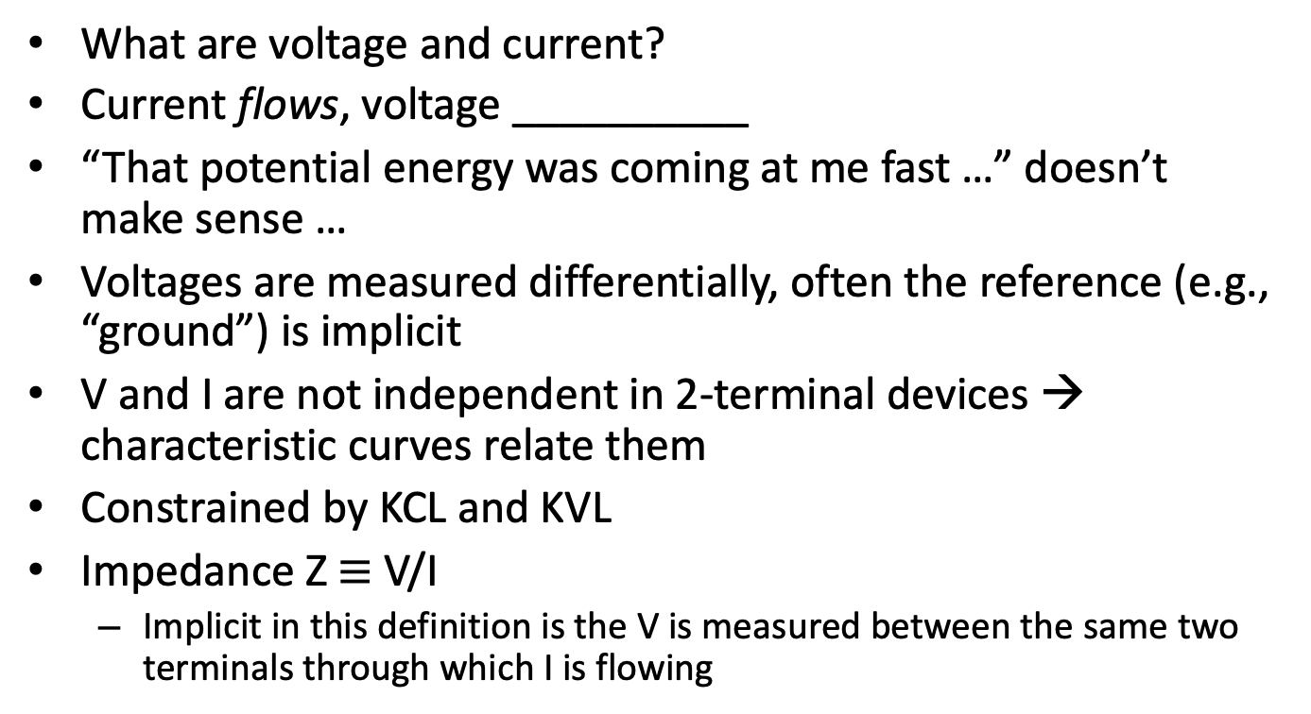
Foundations support the rest …
What are voltage and current?
Current flows, voltage __________
“That potential energy was coming at me fast …” doesn’t make sense …
Voltages are measured differentially, often the reference (e.g., “ground”) is implicit
V and I are not independent in 2-terminal devices → characteristic curves relate them
Constrained by KCL and KVL
Impedance Z $≡$V/I
Implicit in this definition is the V is measured between the same two terminals through which I is flowing

Slide 5
DC circuits
Ohm’s law applies for resistors
Capacitors are open circuits at DC (R=infinity)
Inductors are (approximately) short circuits at DC (R=0)
Diodes are either open or short depending on polarity (except when they’re not … at their I-V “knees”)
KVL (KCL) describe voltage (current) dividers
Thevenin’s theorem simplifies circuits to equivalents
DC voltmeters are generally reliable (except when they’re not)
We could have spent many weeks studying DC circuit theory but I blasted forward to more interesting territory …

Slide 6
Resistance of the LED
Does a LED with V_{f} = 2V at 10mA have resistance R = V/I = 200Ω?
That’s a dangerous way to think about the LED, because its dynamic or differential resistance r=ΔV/ΔI << 200Ω
Remember that diodes are non-linear in their I-V characteristics
I-V curves are useful ways of thinking about and characterizing components

Slide 7
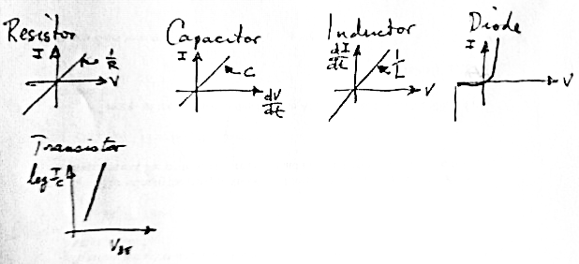
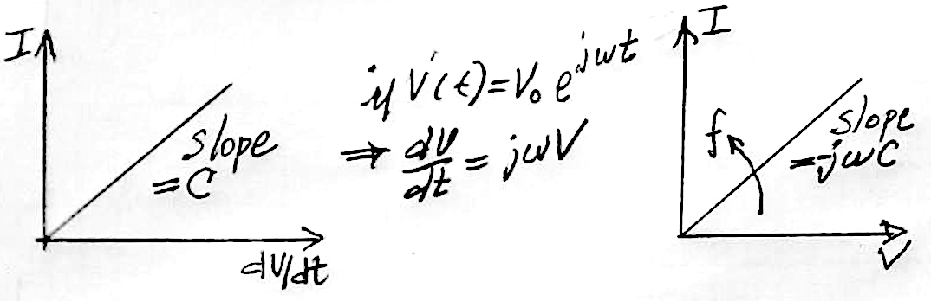
Component transfer functions
We’re building a diverse collection…
Series and parallel combinations create innumerable sums and products
Engineers are skillful at combining these and visualizing the composite “transfer functions”

Slide 8
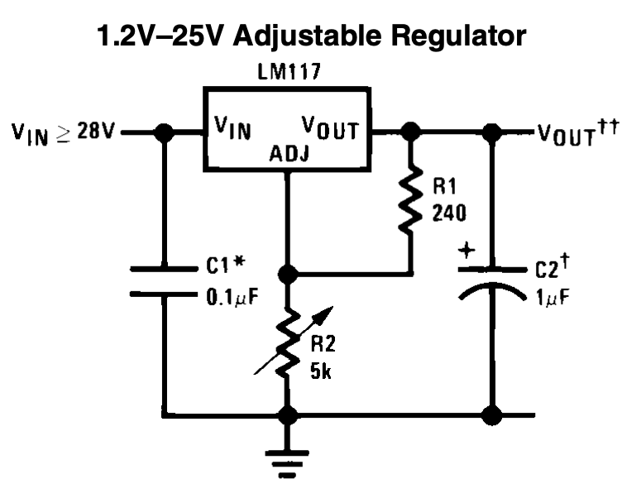
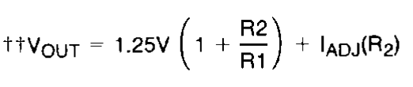
How does an LM317 work?
How does a car work? How much do we need to know?
The 317 is a sophisticated IC. The following circuit’s characteristics are described by the equation below
Digging deeper into the data sheet provides a path for Arduino control:
Vout – Vadj = 1.25V
R1 turns that constant voltage into a current, I = 1.25V/R1 which flows through R2
Vout = IR2 + 1.25V … adding a parallel path for I (“shunting” R2) will lower Vout.
A current mirror enables Arduino to control the R2 shunt or ”bypass”

Slide 9
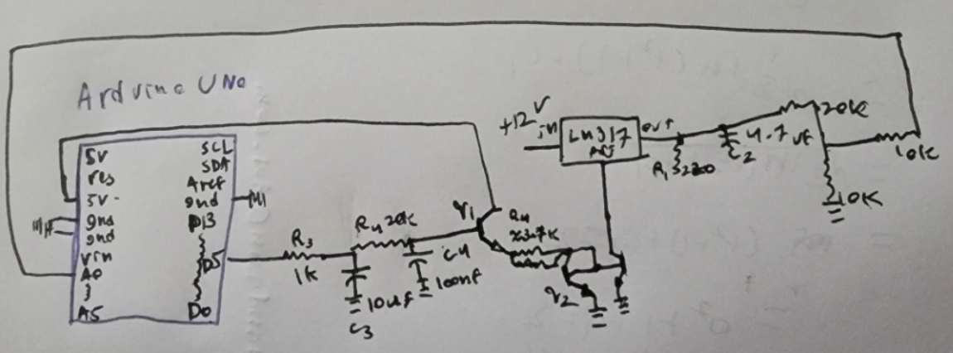
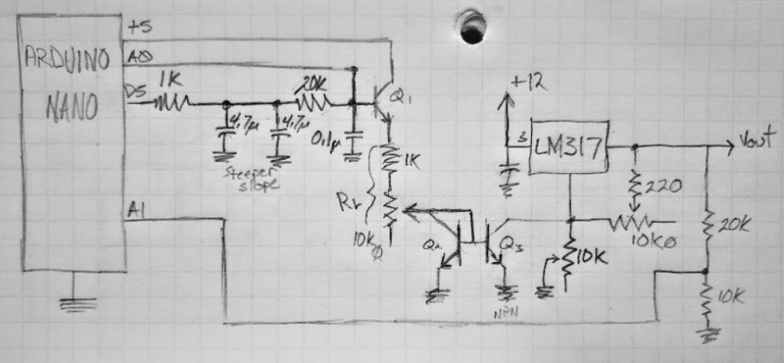
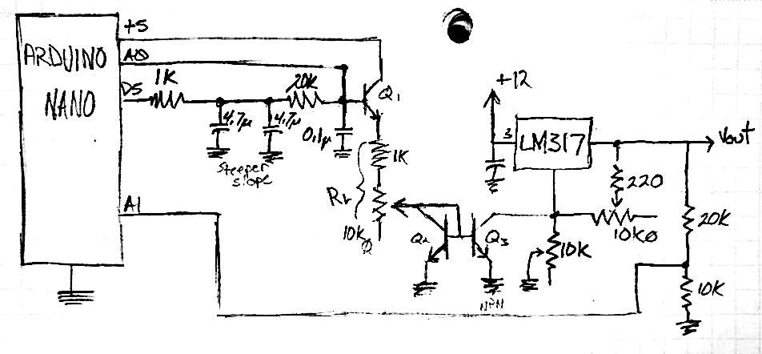
Which will be easier to debug?

Slide 10
LM317 Automation
Objective: Design, prototype, build, characterize, an Arduino controlled LM317 power supply
Methods: break it down into steps to handle the complexity of the task … Design, prototype, build, characterize are good first “cuts”. Some maybe broken down further, e.g.,
PWM filter
Emitter follower
Current mirror
Calibration
Simulation
Theory 1
Theory 2
Theory 3
Reductionism lets you focus all attention on the part, then move onto laser focus on the next part.

Slide 11
PWM filter
What is PWM?
Should you trust intuition, or look it up???
https://docs.arduino.cc/learn/microcontrollers/analog-output

Slide 12
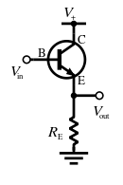
Emitter follower
One of just 4 single BJT circuits described in lecture and our book (switch, follower, current source, and amplifier)
Pg. 350 of our book, or I went to Wikipedia, which redirected to: https://en.wikipedia.org/wiki/Common_collector
Applications: “The low output impedance allows a source with a large output impedance to drive a small load impedance; it functions as a voltage buffer. In other words, the circuit has current gain (which depends largely on the h_{FE} of the transistor) instead of voltage gain …”
You can’t guess or intuit this stuff, but you can rewire your brain to think this way … with practice, patience, perseverance …

Slide 13
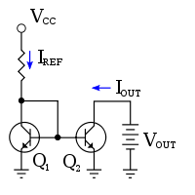
Current Mirror
https://en.wikipedia.org/wiki/Current_mirror
One of a few 2-transistor circuits we discussed in lecture …
“A current mirror is a circuit designed to copy a current through one active device by controlling the current in another active device of a circuit …”
The reference current, I_{REF}, can be programmed by V_{PWM} / R_{E}.
The PWM filter’s high impedance required an emitter follower as “buffer” to provide mA of I_{REF} .
I can write this gobbledygook 100 different ways, but you’ll only learn to speak and think electronic-ese by writing it yourself, reading it back, saying it out loud, singing it in the shower, and repeating until it gets a little clearer …

Slide 14
Prototyping
This is too complicated to just solder together and expect it to work
Solderless breadboarding facilitates exploration of the circuit and our skills at building … with 3 transistors (9 pins), a handful of R’s and C’s, there are lots of opportunities for errors (resulting in the d*%$ thing not working)
How to test??
writeline(ard, ”p 100”) and other values gives way to systematic automated testing

Slide 15
AC circuits
Overview: Long ago electronics was about transferring power, but now most applications involve transferring information
Electrical signals represent dynamic variables (like sound intensity, light patterns, heartbeats, computer data files.
How do we build circuits and devices that can transduce, transform, and transmit/receive these signals? These signals will be AC (or by Fourier’s theorem have AC components).
Our approach is to rely on Fourier’s theorem
Complex waveforms can change in linear circuits, but sine waves only change their amplitude and phase
So we studied simple circuits in terms of their responses to sine waves
Modeling these responses using complex numbers or graphical “phasors” lets us keep generalized forms of Ohm’s law, KVL, and KCL

Slide 16
Fourier’s theorem & complex numbers
In the engineering club you don’t need to understand something in order to use it (carefully)
Check out http://en.wikipedia.org/wiki/Fourier_analysis and http://en.wikipedia.org/wiki/Complex_number for introduction (go as deep as you can handle – also youtube)
What you need to know for our practical purposes:
Any complicated signal or waveform is a sum of sine waves of various frequencies (and amplitudes and phases): FT(S(t)) = S(ω)
A complex number is a useful data structure for dealing with sine waves that have scalar amplitude and phase
This is a very “practical” side to Fourier and Complex analyses
Don’t expect it to make much sense the first (or 2nd) time you see it
Fourier mathematics plays a Universal role in engineering and physics

Slide 17
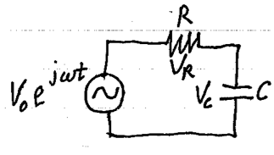
R-C circuit lab
There were many difficulties. In my lab, I discovered many pitfalls too:
Wiggling wires in the solderless breadboard can be unreliable
Uninsulated clip leads can short component leads
Function generator doesn’t recover instantly from being shorted
Grounding different parts of the circuit with oscilloscope probe
That’s the difference between “differential” and “single-ended” voltage measurements
Easy to misread, miswrite, or enter data in wrong column
Can’t ignore j=sqrt(-1); Zc is “perpendicular” to R
Imaginary
Vr
Real
Vo
Vc

Slide 18
R-C circuit lab
What does this diagram look like at f_{c}?
Is this diagram above or below fc?
Imaginary
Vr
Real
Vo
Vc
Imaginary
Vr
Real
Vo
Vc

Slide 19
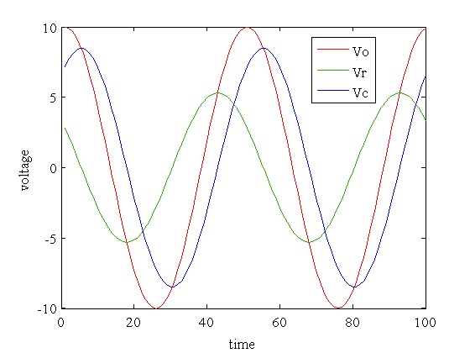
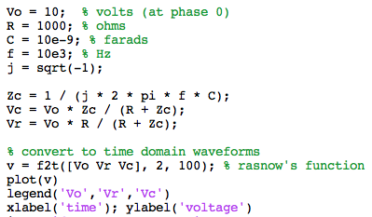
Matlab simulation

Slide 20
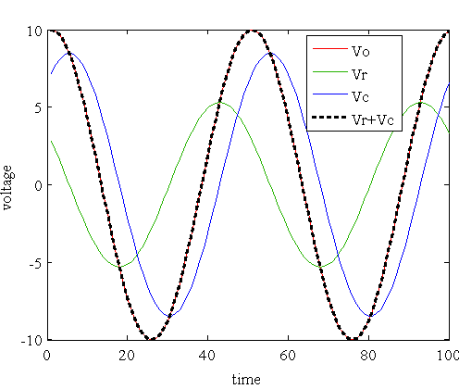
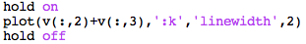
KVL applies at all times
The capacitor’s current is out of phase with its voltage
The current is the same through all components in a series circuit
The resistors current is always in phase with its voltage, so Vr is proportional to the current, which lags the voltage because of the capacitor
Vr and Vc are always 90 degress out of phase
Both Vr and Vc are of different phase than the source Vo
At fc, |Vr| = |Vc| at phases of +-45 degrees relative to Vo

Slide 21
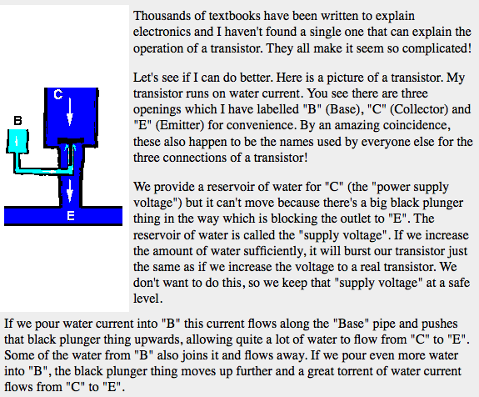
Transistor as a valve
A small base-emitter current controls a much larger collector-emitter current
http://www.satcure-focus.com/tutor/page4.htm (google “transistor tutorial” for many other explanations)

Slide 22
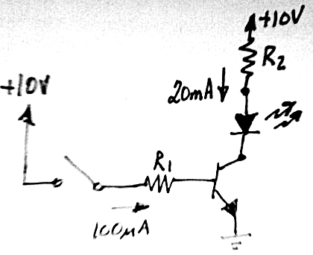
Transistor Switch
How to pick R₁ and R₂?
Why doesn’t the precise value of β matter in this circuit?
2N2222
100μA

Slide 23
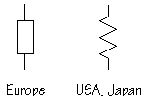
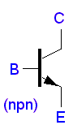
Simplest 1-transistor circuits
Fixing or floating various terminals gives various circuit properties (and a whole lot to remember and get confused about), e.g.,
fixed
out
fixed
out
R₁
i_{out} < βi_{in}
i = V_{e}/R
out
fixed
in
G = -R₁/R₂
in
in
fixed
out
Z_{out} = Z_{in}/β
R₂
fixed
fixed
Switch
Follower
Current source (sink)
Amplifier
From these 4 abstractions we built

Slide 24
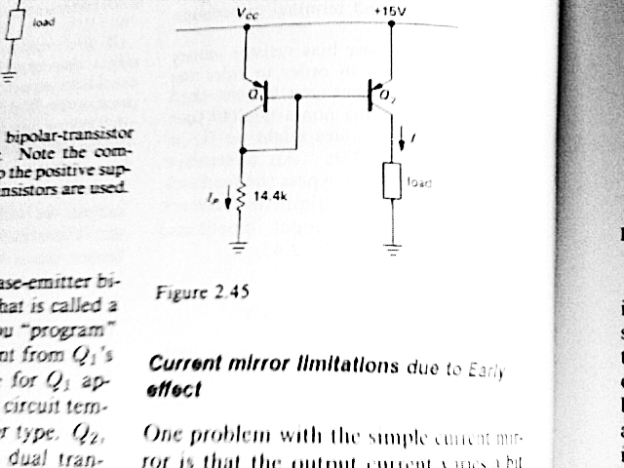
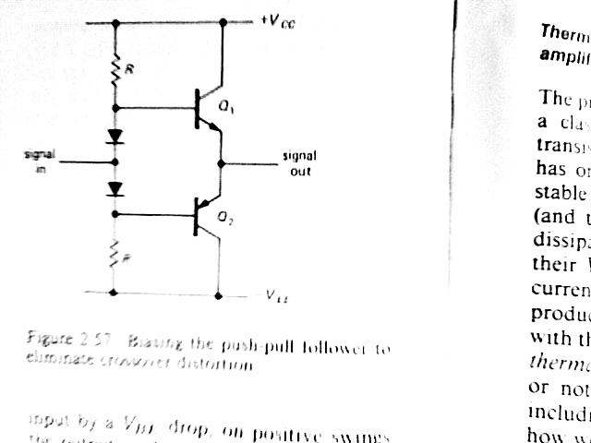
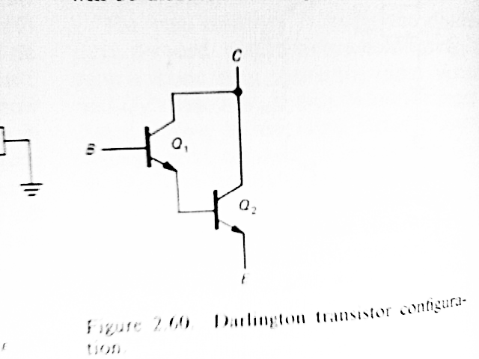
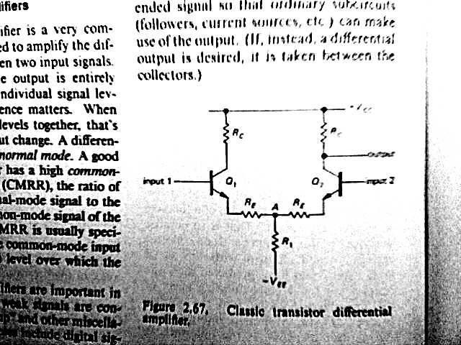
2-transistor circuits
Push Pull Amplifier
Darlington
(super-beta)
transistor
Current Mirror
Differential
amplifier

Slide 25
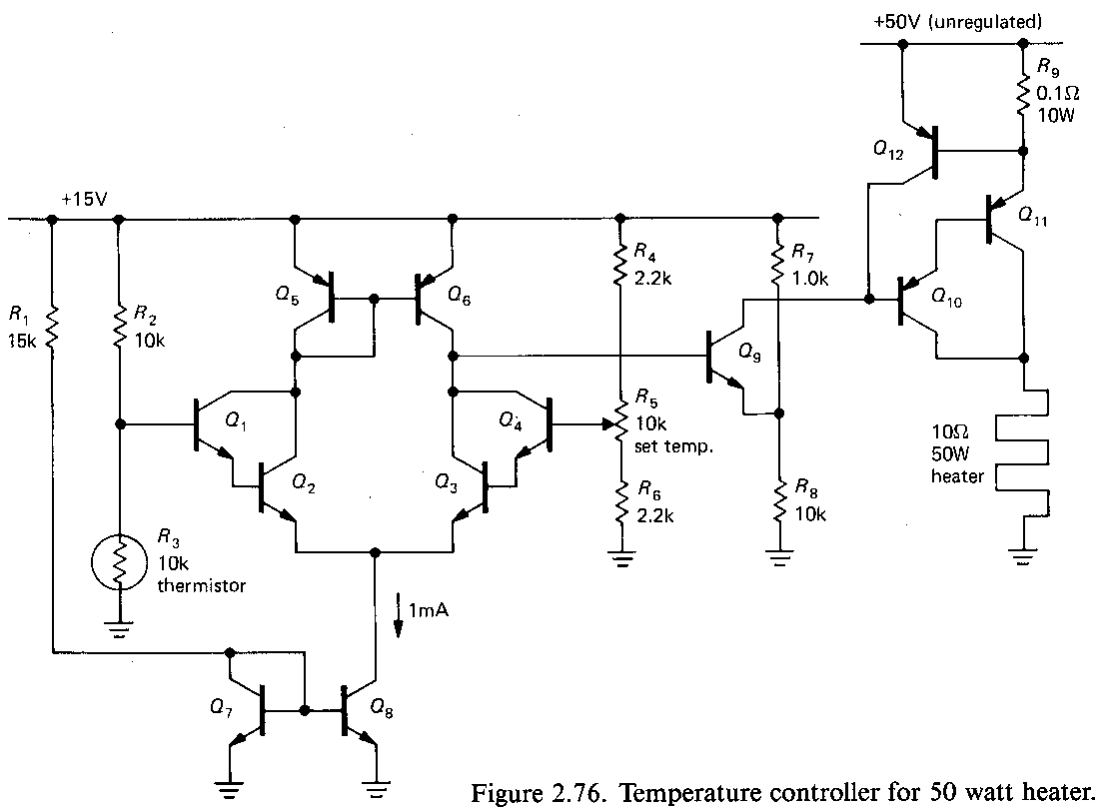
Which familiar circuits do you see?
Knowing 1 & 2 transistor circuits allows you to quickly visually parse and understand more complex ones

Slide 26
Which familiar circuits do you see?
Voltage dividers
Switch/regulator
Knowing 1 & 2 transistor circuits allows you to quickly visually parse and understand many more complex circuits
Differential amp
Current
mirror
darlington
Current
sink
darlington
darlington
Current
mirror
Learn to see higher level, more abstract semantic elements

Slide 27
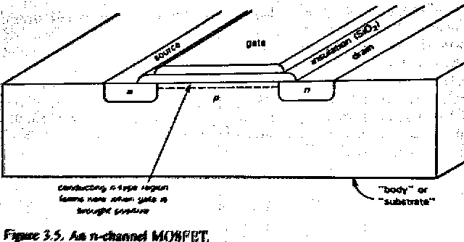
How the n-FET works
Conduction between Source and Drain is controlled by E field between Gate and substrate
Conduction can be bidirectional
4 terminal device, though generally substrate connected to S or D
~zero gate current (R_{gate} ~10¹⁴)
http://www-g.eng.cam.ac.uk/mmg/teaching/linearcircuits/mosfet.html

Slide 28
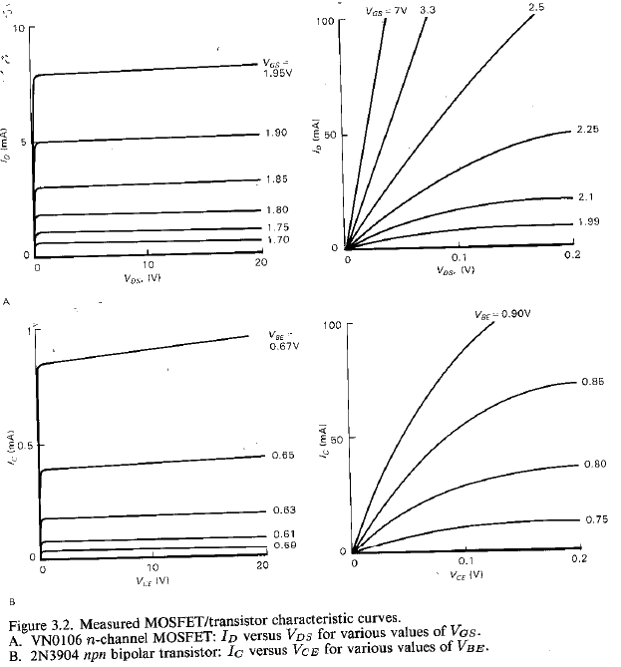
n-MOSFET vs. BJT
Higher V_{GS} ~2V vs. V_{BE} ~.7V.
Infinite DC Z_{G} vs. low Z_{B}.
Parasitic capacitances dominate high frequency impedances
Often VERY ESD sensitive
Highly non-linear, described by multiple models of increasing complexity → use ICs if you seek linear behaviors (e.g., voltage regulator ICs, op-amps, etc. )

Slide 29
Inverting and non-inverting op-amp amplifiers
Op-Amp “Golden rules”: When the op-amp is not saturated:
The inputs are at the same voltage
The inputs draw no current
Stability of a device with infinite gain is achieved by negative feedback
Negative feedback can make stable systems from unstable parts

Slide 30
Analog math
Op-amps can make adders and multipliers, filters, log converters, etc.
They do this math in real time on voltages and currents, without requiring transformations to binary representations (and associated nonlinearities and errors)

Slide 31
Microcontrollers and Microcomputers
This much flexibility and power at such low cost will radically change our world … get ready!
uCs allow you to implement complex transfer functions, interfaces, and measurements much faster than with solder and simpler components alone
Bootstrap the hardware and software …
Use the hardware and software platform to test, validate, and evolve the design and interfaces
Develop and practice good coding techniques
E.g., self-documenting code instead of comments

Slide 32
Transduction, Transformation, Transmission
My favorite 3 “T”s
We’ve seen examples of how to do these using solid state physics
Biology also mastered these challenges, using carbon-based substrates …
Biologically inspired computing I think is one of coolest fields

Slide 33
Apple M1 Ultra
*
Apple M1
*
There are more transistors on earth now than the number of leaves on plants

Slide 34
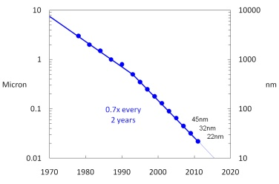
Transistor dimension evolution
5nm
O
Apple M1
~130

Slide 35
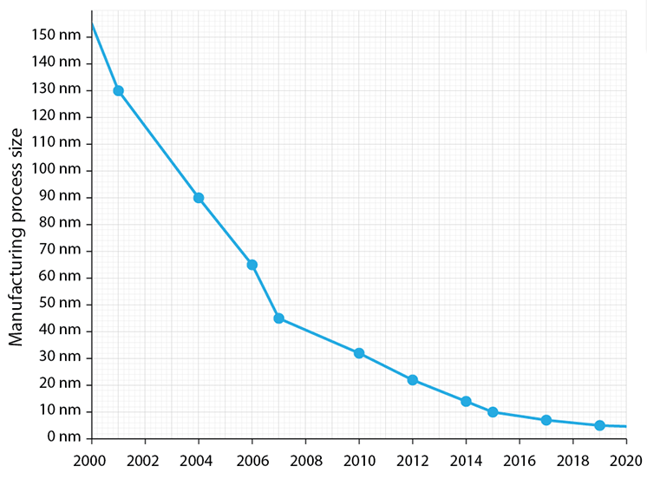
Diminishing returns

Slide 36
What’s the future of Moore’s Law?
Not good …
Exponential growth eventually must flatten out in a finite world
Whether the boundary is atomic dimensions for transistors
“Peak oil” for fossil fuels (increasing cost of extraction)
Peak population for humans (depletion of ecosystem)
Crashes in capitalist (and other) economic systems
Technological advances can defer the catastrophe …
New paradigms can change the dynamics …
But eventually natural law will stop growth
Not just in electronics, we have reason to expect our future won’t be like the past …
We just don’t know when and how that change will occur …

Slide 37
Pace of Change
The rate at which our world is changing is unprecedented
Education can’t prepare you for future jobs when nobody knows what those jobs will entail
How many carpenters, plumbers, typists, mechanics, nurses, … will exist, and what technologies will they rely on?
Automation has radically transformed manufacturing; it appears poised to transform transportation and many information processing jobs
The best preparation for the uncertain future is developing a strong ability to learn new skills and continually recreate yourself
Stay sharp and nimble
Don’t overspecialize (too soon)
https://www.ted.com/talks/sir_ken_robinson_bring_on_the_revolution

Slide 38
Pace of Change
“The dogmas of the quiet past are inadequate to the stormy present. The occasion is piled high with difficulty, and we must rise with the occasion. As our case is new, so we must think anew and act anew. We must disenthrall ourselves, and then we shall save our country.”
– Abraham Lincoln to Congress 1862
(Civil War was 1861 to 1865)

Slide 39
Lessons from Electronics
Robust complex systems can be built, bootstrapped, by isolating, testing, and validating components
Trust nothing without validation
Build systems to facilitate troubleshooting and debugging, “plan for failure”
Be guided by empiricism, by experimental results, and models that co-evolve to explain empirical data
Constantly adapt … you’re never “there”, always learning and growing and changing …
Physics is hard: “The job of science is to look beyond our intuitions and find out by any means possible what’s really going on, and to give up old ways of thinking when the evidence requires it”
Learn where to find answers – parsing datasheets, Wikipedia, google, Arduino.cc, …
May the Electromagnetic Force be with you …

Slide 40
Arduino Lessons
Keep analog inputs between 0-Vref (5V for Nano, 3.3V for some other Arduinos)
Analog input Z is high, so 10kohms in series offers current-limiting protection
Don’t draw more than 10’s of mA from 5V or digital outputs
If you’re not powering the Arduino from USB, a series resistor to its power supply lets you measure its current and limit it too
Use FETs or BJTs to switch higher voltages or currents
Build and debug incrementally
Test as you go – e.g., use Blink to test communication
Use ascii format before binary
…

Slide 41
Metaprogramming
http://poignant.guide (perhaps the wackiest programming book), page 107:
“When one learns to learn, one is making models, using symbols, analogizing, making metaphors, in short, inventing and using language, mathematics, art, politics, business, etc. At the critical brain (cortex) size, languages and its consequences appear. To avoid the necessity of repeating learning to learn, symbols, metaphors, models each time, I symbolize the underlying idea in these operations as metaprogramming.”
JOHN C. LILLY, PROGRAMMING AND METAPROGRAMMING IN THE HUMAN BIOCOMPUTER, NEW YORK, 1972.

Slide 42

The Society of Mind
https://www.amazon.com/Society-Mind-Marvin-Minsky/dp/0671657135/
Remarkable for its time (1988) and pedagogy (1 page/chapter)

Slide 43
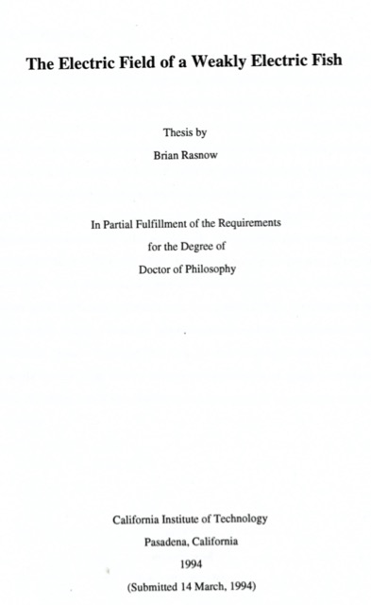
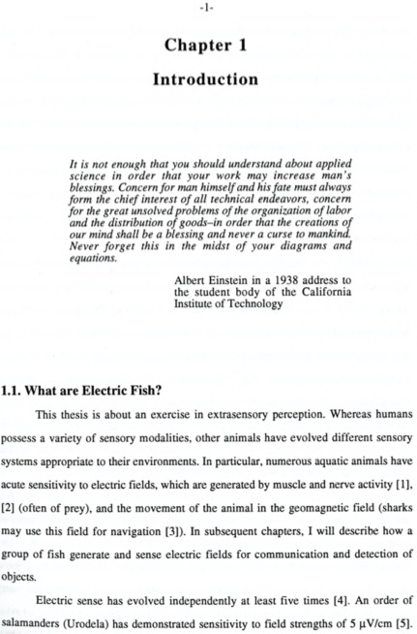

Slide 44
Recommended lectures and films
https://hiddenbrain.org/podcast/one-head-two-brains/
https://www.hbo.com/exterminate-all-the-brutes
Reviewed at https://theintercept.com/2021/05/02/exterminate-all-the-brutes-hbo/
https://www.hbo.com/documentaries/the-crime-of-the-century
Follow/join organizations working for positive change
Stay aware of our political/economic/social situation
The powerful few who’ve created our economic system are fighting to maintain their power and privilege, while others are fighting to change course to mitigate global ecological, social, and climatic crises
Profound change is coming – either by choice or laws of nature
Better to anticipate the apocalypse (and work strategically to reduce its negative impacts)

